Slide 1

Airbnb NYC
Sam Noori

Slide 2
Project/Goals
Transform complex data into easily understandable visualizations using Tableau, enabling the viewer to make informed decisions in response to the inquiries. Utilize compelling dashboards that effectively convey insights and employ appropriate visual representations to effectively communicate findings.

Slide 3
Process
1. Define the project goal: Clearly identify the objective of the project.
2. Import the dataset into Tableau: Load the cleaned dataset into Tableau.
3. Data exploration and visualization: Using Tableau's visualization capabilities to explore the dataset and identify interesting patterns and trends.
4. Perform data analysis: Utilizing Tableau's analytical tools to conduct deeper analysis on the dataset.
5. Create interactive dashboards: Designed an interactive dashboards using Tableau's drag-and-drop interface.
6. Incorporate storytelling: Crafted a compelling narrative by combining the visualizations into a coherent and insightful story.

Slide 4
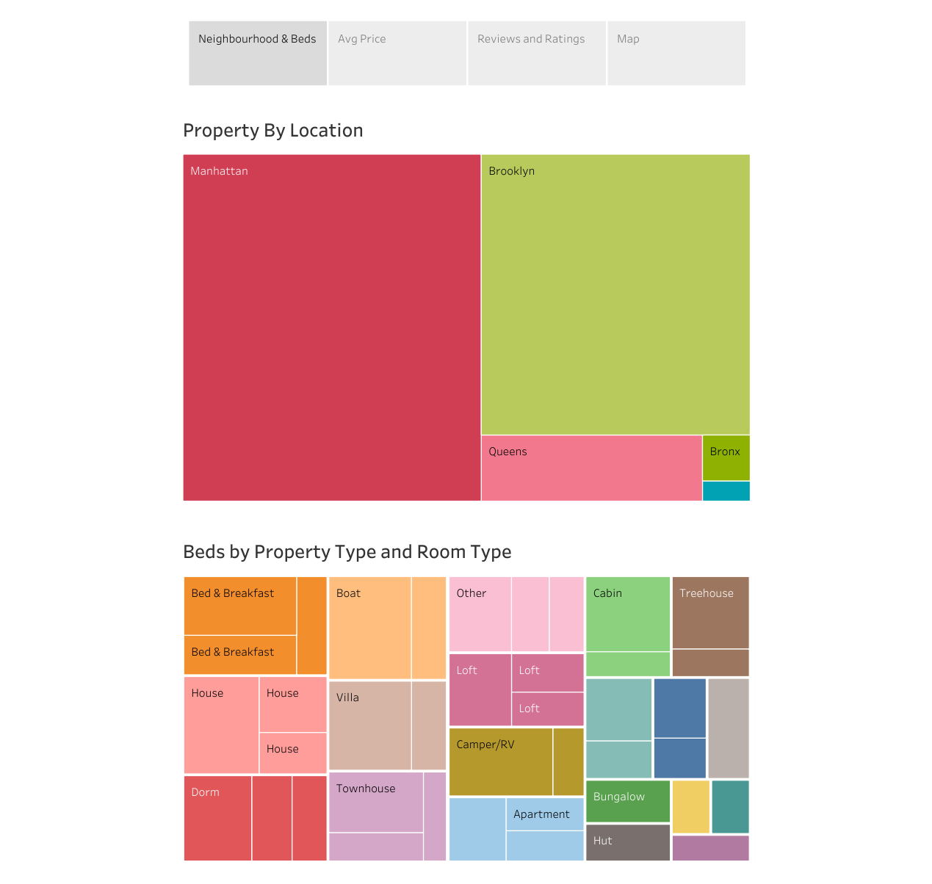

Slide 5
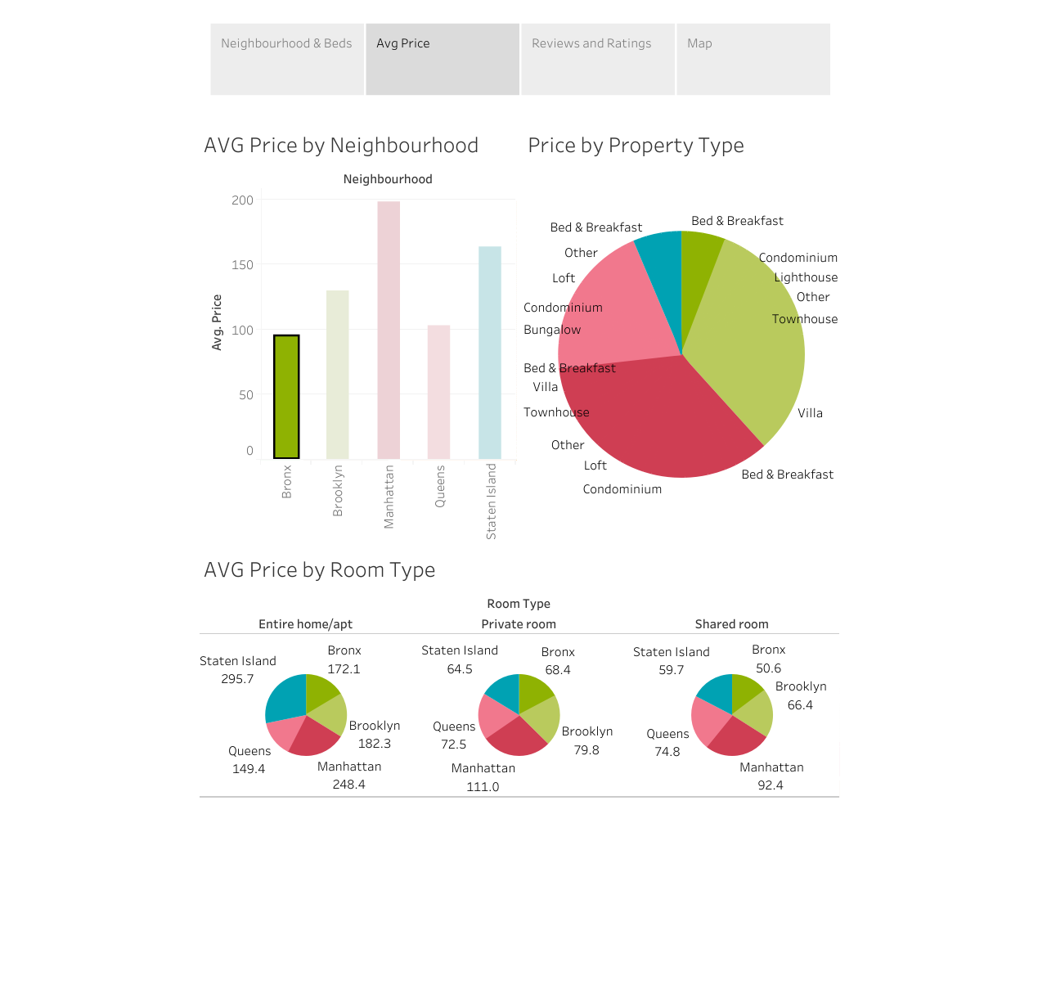

Slide 6
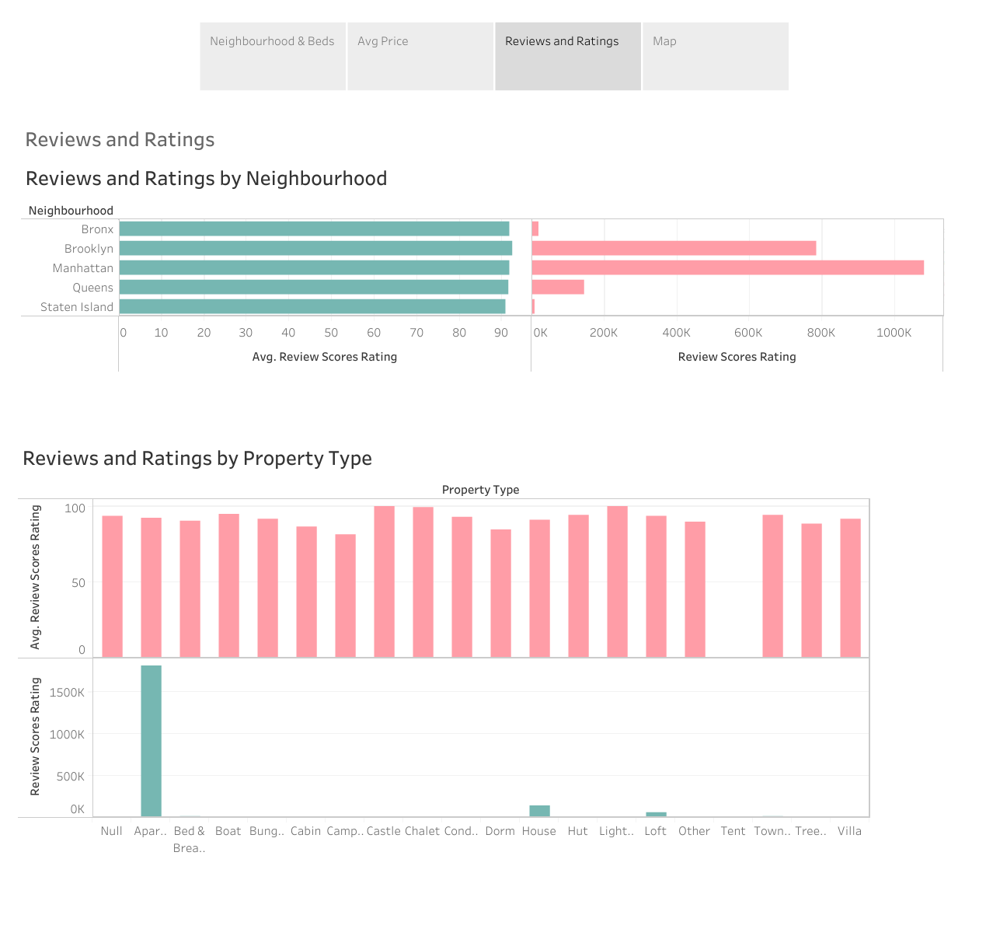

Slide 7
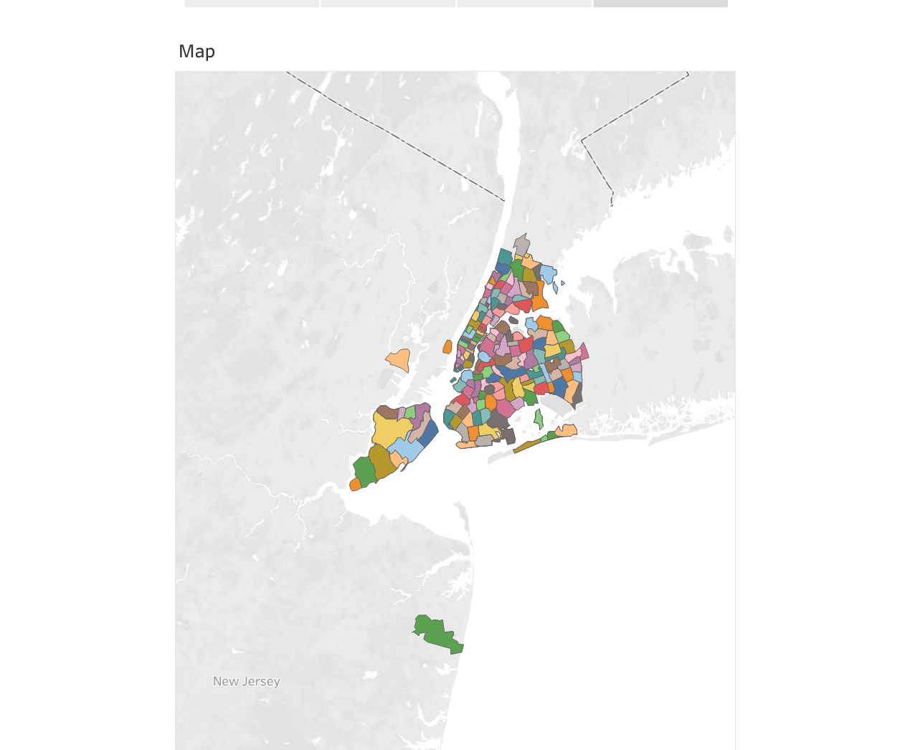


Slide 8
Thank you
Sam Noori

